Slide 1
WQD7010 Network & Security
Dr. Saaidal Razalli Bin Azzuhri
Dept. of Comp System & Technology
Fac. of Science Comp & IT.

Slide 2
L3: Asymmetric Encryption Technique and Message Authentication (outline)
Asymmetric encryption
– components
– principle
Asymmetric Encryption algorithms
– RSA algorithm
– Diffie-Hellman key exchange
Message Authentication Code
Hash Function
Digital signatures

Slide 3
Symmetric Cryptography
Traditional private/secret/single key cryptography uses only one key
The key is shared by both sender and receiver
Security is compromised if this key is disclosed, intentionally or unintentionally
Concern:
– Key exchange
– Number of keys required is directly proportional to the number of sender/receiver pairs
– Does not protect sender from receiver forging a message & claiming it is sent by sender

Slide 4
Asymmetric Cryptography (Overview)
Uses two keys – a public & a private key
Asymmetric since parties are not equal
Uses clever application of number theory concepts to function
Complements rather than replacing private key crypto

Slide 5
Asymmetric Cryptography (Overview)
The key pair (k1 and k2) is related such that the data encrypted by k1 can only be decrypted by its corresponding pair k2
Any of the keys can be used for encryption and the other for decryption
Of the key pair
– private key - one of the keys is kept secret by the owner (hence called private key)
– public key - the other is published (hence called public key)
Even if someone has one key, he/she can’t compute the other

Slide 6
Public-Key encryption structure
First publicly proposed by Diffie and Hellman in 1976
Based on mathematical functions rather than on simple operations on bit patterns
Is asymmetric, involving the use of two separate keys
Misconceptions:
Public-key encryption is more secure from cryptanalysis than conventional encryption
Public-key encryption is a general-purpose technique that has made conventional encryption obsolete
There is a feeling that key distribution is trivial when using public-key encryption, compared to the rather cumbersome handshaking involved with key distribution centers for conventional encryption
Notes:
Public-key encryption, first publicly proposed by Diffie and Hellman in 1976
[DIFF76], is the first truly revolutionary advance in encryption in literally thousands
of years. Public-key algorithms are based on mathematical functions rather
than on simple operations on bit patterns, such as are used in symmetric encryption
algorithms. More important, public-key cryptography is asymmetric, involving the
use of two separate keys—in contrast to the symmetric conventional encryption,
which uses only one key. The use of two keys has profound consequences in the
areas of confidentiality, key distribution, and authentication.
Before proceeding, we should first mention several common misconceptions
concerning public-key encryption. One is that public-key encryption is more
secure from cryptanalysis than conventional encryption. In fact, the security of any
encryption scheme depends on (1) the length of the key and (2) the computational
work involved in breaking a cipher. There is nothing in principle about either conventional
or public-key encryption that makes one superior to another from the
point of view of resisting cryptanalysis. A second misconception is that public-key
encryption is a general-purpose technique that has made conventional encryption
obsolete. On the contrary, because of the computational overhead of current public-
key encryption schemes, there seems no foreseeable likelihood that conventional
encryption will be abandoned. Finally, there is a feeling that key distribution
is trivial when using public-key encryption, compared to the rather cumbersome
handshaking involved with key distribution centers for conventional encryption.
In fact, some form of protocol is needed, often involving a central agent, and the
procedures involved are no simpler or any more efficient than those required for
conventional encryption.

Slide 7
Asymmetric Cryptography (Overview)
Description:
Encryption and decryption are thought of as locking and unlocking padlocks with keys.
The padlock is locked with a public key can be unlock only with the corresponding private key.
Example:
• Alice locks the padlock with Bob’s public key, then only Bob’s private key can unlock it.

Slide 8
Asymmetric Cryptography (Overview)
The encryption scheme has the following components:
> plaintext
> encryption algorithm
> Private & public key pair
– public key-can be used by anyone
– private key- known to the owner only
> ciphertext
> decryption algorithm
Asymmetric because
– those who encrypt the message cannot decrypt it
– those who verify the signature cannot create it

Slide 9
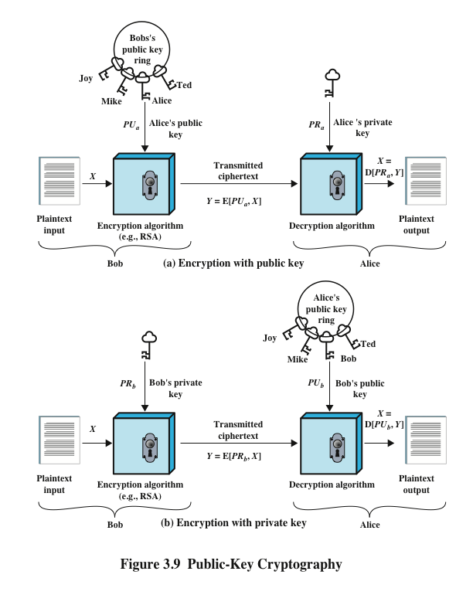
Notes:
A public-key encryption scheme has six ingredients (Figure 3.9a).
• Plaintext: This is the readable message or data that is fed into the algorithm as
input.
• Encryption algorithm: The encryption algorithm performs various transformations
on the plaintext.
• Public and private key: This is a pair of keys that have been selected so that if
one is used for encryption, the other is used for decryption. The exact transformations
performed by the encryption algorithm depend on the public or
private key that is provided as input.
• Ciphertext: This is the scrambled message produced as output. It depends on
the plaintext and the key. For a given message, two different keys will produce
two different ciphertexts.
• Decryption algorithm: This algorithm accepts the ciphertext and the matching
key and produces the original plaintext.
As the names suggest, the public key of the pair is made public for others to
use, while the private key is known only to its owner. A general-purpose public-key
cryptographic algorithm relies on one key for encryption and a different but related
key for decryption.
The key used in conventional encryption is typically referred to as a secret
key . The two keys used for public-key encryption are referred to as the public key
and the private key . Invariably, the private key is kept secret, but it is referred
to as a private key rather than a secret key to avoid confusion with conventional
encryption.

Slide 10
Why Asymmetric Encryption
• Developed to address two key issues:
– key distribution – how to have secure communications in general without having to trust a Key Distribution Centre (KDC) with your key
– digital signatures – how to verify a message comes intact from the claimed sender
Public invention due to Whitfield Diffie & Martin Hellman at Stanford Uni in 1976
– known earlier in classified community

Slide 11
Symmetric VS Asymmetric (Public Key)

Slide 12
Public Key characteristic
Public-Key algorithms rely on the following characteristics :
– computationally easy for a party B to generate a key
pair (public key KU_{B}, private key KR_{B}) for message M
– easy for sender to generate ciphertext:
> C=E_{KUB}(M)
– easy for the receiver to decrypt ciphertext using private key
– M=D_{KRB}(C)=D_{KRB}[E_{KUB}(M)]

Slide 13
Public Key Characteristics
Public-Key algorithms rely on the following characteristics :
– computationally infeasible to determine private key (KRB) knowing public key (KUB)
– computationally infeasible to recover message M, knowing KUB and ciphertext C
– either of the two keys can be used for encryption, with the other used for decryption:
M = DKUB[EKRB(M)] = DKRB[EKUB(M)]

Slide 14
Public Key Application
Three categories of use:
- encryption/decryption (provide secrecy)
- digital signatures (provide authentication)
- key exchange (of session keys)
Some algorithms are suitable for all uses, others are specific to one
The use of public-key cryptosystems can be classified into three categories:
Encryption/decryption
The sender encrypts a message with the recipient’s public key
Digital signature
The sender “signs” a message with its private key
Key exchange
Two sides cooperate to exchange a session key

Slide 15
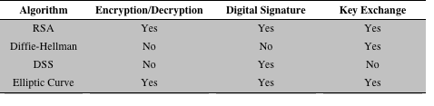
Applications for public-key cryptosystems
Notes:
Some algorithms are suitable for all three applications, whereas others can be
used only for one or two of these applications. Table 3.2 indicates the applications
supported by the algorithms discussed in this chapter: RSA and Diffie–Hellman.
This table also includes the Digital Signature Standard (DSS) and elliptic-curve
cryptography, also mentioned later in this chapter.
One general observation can be made at this point. Public-key algorithms
require considerably more computation than symmetric algorithms for comparable
security and a comparable plaintext length. Accordingly, public-key algorithms
are used only for short messages or data blocks, such as to encrypt a secret key
or PIN.

Slide 16
Mathematical Background: Prime Numbers
Prime Numbers:
– prime numbers only have divisors of 1 and self
> they cannot be written as a product of other numbers
> note: 1 is prime, but is generally not of interest
– Example:-
> 2,3,5,7 are prime,
> 4,6,8,9,10 are not prime
– prime numbers are central to number theory
– list of prime number less than 200 is:
> 2 3 5 7 11 13 17 19 23 29 31 37 41 43 47 53 59 61 67 71 73 79 83 89 97 101 103 107 109 113 127 131 137 139 149 151 157 163 167 173 179 181 191 193 197 199

Slide 17
Mathematical Background: Factorization
Prime Factorization:
– to factor a number n is to write it as a product of
other numbers: n = a x b x c
>Example: 3600 = 2⁴ x 3² x 5²
– factoring a number is relatively hard compared to
multiplying the factors together to generate the number
– the prime factorization of a number n is when it is
written as a product of primes
> e.g. 91 = 7 x 13 ;

Slide 18
Mathematical Background: GCD
Greatest Common Divisor (gcd):
– gcd of integers a & b is an integer c if
> c is divisor of both a & b; and
> any divisor of a & b is a divisor of c
– gcd can be determined by comparing their prime factorizations and using least powers
Example:
» 300=2² x 3¹ x 5² = 2 x 2 x 3 x 5 x 5 x 5⁰
» 18=2¹ x 3² = 2 x 3 x 3 x 5⁰
» gcd(18,300)=2¹ x 3¹ x 5⁰ = 6

Slide 19
Mathematical Background: Modular Arithmetic
Modular arithmetic:
In modular arithmetic, numbers "wrap around" upon reaching a given fixed quantity, which is known as the modulus:
> 12 mod 7=5; 15 mod 12 = 3
define modulo operator “a mod n” to be remainder when a is divided by n
The (mod n) operator maps all integers into the set of integers {0,1,…., n-1}
Two integers a & b are said to be congruent modulo n, if (a mod n) = (b mod n);
> congruence is written as a ≡ b mod n
> example: 73 ≡ 4 mod 23
73 mod 23 = 4 & 4 mod 23 = 4

Slide 20
Mathematical Background: Primitive Root
a is a Primitive Root of prime number p
If a^{n} mod p = 1 to p-1 (distinct integers)
Where n is an integer 1 through p-1
Then a is the primitive root of p
We will try a^{n} mod 7
a\a^n | 1 | 2 | 3 | 4 | 5 | 6
1 | 1 | 1 | 1 | 1 | 1 | 1
2 | 2 | 4 | 1 | 2 | 4 | 1
3 | 3 | 2 | 6 | 4 | 5 | 1
4 | 4 | 2 | 1 | 4 | 2 | 1
5 | 5 | 4 | 6 | 2 | 3 | 1
6 | 6 | 1 | 6 | 1 | 6 | 1

Slide 21
Asymmetric Encryption Algorithms
Like symmetric encryption brute force exhaustive search attack is always theoretically possible
But keys used are too large ( e.g. 1024 bits)
Requires the use of very large numbers
Hence is slow compared to symmetric encryption

Slide 22
Asymmetric Encryption Algorithms
Two widely used algorithms:
RSA Algorithm
developed by Ron Rivest, Adi Shamir and Len Adleman at MIT proposed in 1978
security relies on the cost of factoring large numbers
Diffie-Hellman Algorithm
developed by Whitfield Diffie and Martin Hellman in 1976
security relies on the difficulty of computing discrete logarithms

Slide 23
RSA Algorithm – Key generation
Steps involve:
– select two large primes number p, q at random
– calculate N = p × q
– calculate euler’s totient function, ø(N) = (p-1)(q-1)
– Select an integer e such that
1 < e < ø(N), gcd(e, ø(N))=1
– Select d such that
> d . e ≡ 1 mod ø(N) , i.e., d . e mod ø(N)=1
– public key: KU={e, N}
– private decryption key: KR={d, N}

Slide 24
RSA Example
Example:
– select p=17, q=11 at random
– calculate N=p x q =17 × 11=187
– calculate ø(N)=(p-1) x (q-1)=(17-1) x (11-1)=160
– Select an integer e such that
1 < e < 160, gcd(e,160)=1; choose e=7
– Select d such that d x e ≡ 1 mod 160,
> i.e., d×7 ≡ 1 mod 160; (d×7 mod 160)=1; 161 mod 160=1
> The correct answer is : d = 23
– public key: KU={e, N} == {7,187}
– private decryption key: KR={d, N} == {23,187}

Slide 25
RSA Algorithm
RSA is a block cipher
– each block must have a binary value M < N
– in practice block size is k bits, 2k < N < 2k+1
Encryption mode:
– ciphertext: C = Me mod N
– message, M= C^{d} mod N= (Me)^{d} mod N= M^{ed} mod N
Signature mode:
– signature: S = M^{d} mod N
– message, M= S^{e} mod N= (M^{d})^{e} mod N= (M^{ed})mod N
Note that the message M must be smaller than the modulus N

Slide 26
Requirement of RSA
For RSA algorithm to work satisfactorily, the following requirements must be met:
– It is possible to find values of e, d, N such that M^{ed} = M mod N for all M < N
– It is relatively easy to calculate Me and C^{d} for all values of M < N
– It is infeasible to determine d given e and N. This requirement is met when e and N are very large values

Slide 27
RSA Example – Encryption/Decryption
Given message M = 88 (note: M < N; i.e. 88 < 187)
Encryption: C = Me mod N
C = 88⁷ mod 187 = [(88⁴ mod187) x (88² mod187) x
(88mod187) ] mod 187 =(132x77x88) mod 187 = 11
C = 11
Decryption: M= C^{d} mod N
M = 11²³ mod 187
= [(11¹ mod 187)x(11² mod 187)x(11⁴ mod 187)x(11⁸
mod 187)x(11⁸ mod 187)] mod187
=(11x121x55x33x33)mod187=88

Slide 28
Diffie-Hellman Key Exchange
First public-key algorithm proposed
By Diffie & Hellman in 1976 along with the
exposition of public key concepts
– note: now known that James Ellis (UK CESG) secretly proposed the concept in 1970
A practical method for secure exchange of a secret key
Used in a number of commercial products

Slide 29
Diffie-Hellman Key Exchange
a public-key distribution scheme
– cannot be used to exchange an arbitrary message
– rather it can establish a common key
– known only to the two participants
value of key depends on the participants (and their private and public key information)
based on exponentiation in a finite (Galois) field (modulo a prime or a polynomial) - easy
security relies on the difficulty of computing discrete logarithms (similar to factoring) – hard

Slide 30
Diffie-Hellman Setup
all users agree on global parameters:
– large prime integer or polynomial q
– a being a primitive root of q
each user (e.g. A) generates their key
– chooses a secret/private key (number): x_{A} < q
– compute their public key: y_{A} = a ^{xA}mod q
each user publish their public key y_{A}

Slide 31
Diffie-Hellman Key Exchange
shared session key for users A & B is K_{AB} :-
K_{AB} = a^{xA.XB} mod q
= y_{A}^{xB} mod q (which B can compute)
= y_{B}^{xA} mod q (which A can compute)
KAB is used as session key in private-key
encryption scheme between Alice and Bob
If Alice and Bob subsequently communicate, they will have the same key as before, unless they choose new public-keys
attacker needs an x_{A} or X_{B}, must solve discrete log

Slide 32
Diffie-Hellman Example
Users Alice & Bob who wish to exchange keys:
• both agree on prime number q=353 and primitive root a=3
• select random secret private keys:
– A chooses x_{A}=97, B chooses x_{B}=233
• compute respective public keys:
– y_{A}=3⁹⁷mod 353 = 40 (Alice)
– y_{B}=3²³³mod 353 = 248 (Bob)
• compute shared session key as:
– K_{AB}= y_{B}^{xA}mod 353 = 248⁹⁷= 160 (Alice)
– K_{AB}= y_{A}^{xB}mod 353 = 40²³³= 160 (Bob)

Slide 33
Diffie-Hellman Key Exchange
First published public-key algorithm
A number of commercial products employ this key exchange technique
Purpose of the algorithm is to enable two users to exchange a secret key securely that then can be used for subsequent encryption of messages
The algorithm itself is limited to the exchange of the keys
Depends for its effectiveness on the difficulty of computing discrete logarithms
Notes:
The first published public-key algorithm appeared in the seminal paper by Diffie
and Hellman that defined public-key cryptography [DIFF76] and is generally
referred to as the Diffie–Hellman key exchange . A number of commercial products
employ this key exchange technique.
The purpose of the algorithm is to enable two users to exchange a secret key
securely that then can be used for subsequent encryption of messages. The algorithm
itself is limited to the exchange of the keys.
The Diffie–Hellman algorithm depends for its effectiveness on the difficulty
of computing discrete logarithms.

Slide 34
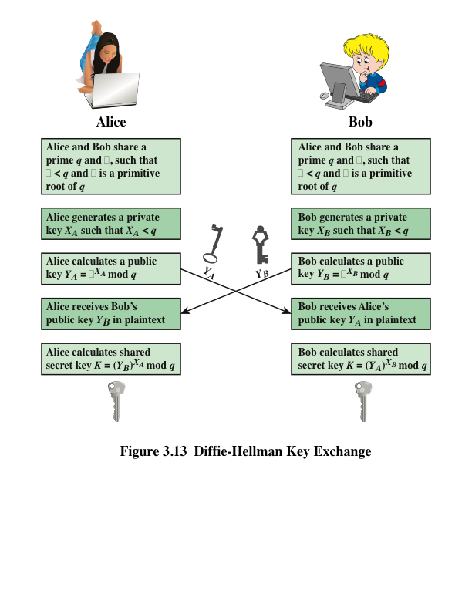
Notes:
The Diffie–Hellman key exchange is summarized in Figure 3.13.

Slide 35
Key Exchange Protocol
users could create random private/public D-H keys each time they communicate
users could create a known private/public D-H key and publish in a directory, then consulted and used to securely communicate with them
both of these are vulnerable to a man-in-the- Middle Attack
Hence; authentication of the keys is needed

Slide 36
Man-In-The-Middle-Attack
• Darth prepares by creating two set of
private / public key pairs
• Alice transmits her public key to Bob
• Darth intercepts this and transmits his first
public key to Bob. Darth also calculates a
shared key with Alice
• Bob receives the public key and calculates
the shared key (with Darth instead of Alice)
• Bob transmits his public key to Alice
• Darth intercepts this and transmits his
second public key to Alice. Darth calculates a shared key with Bob
• Alice receives the key and calculates the
shared key (with Darth instead of Bob)
• Darth can then intercept, decrypt, reencrypt,
forward all messages between Alice & Bob

Slide 37
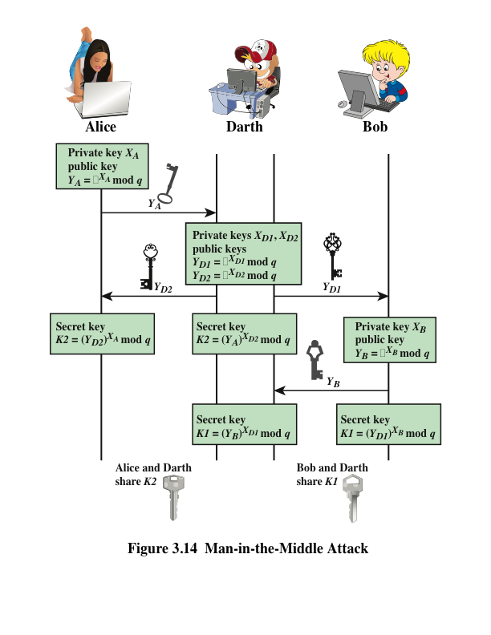
Notes:
The protocol depicted in Figure 3.13 is insecure
against a man-in-the-middle attack. Suppose Alice and Bob wish to exchange keys,
and Darth is the adversary. The attack proceeds as follows (Figure 3.14).
The key exchange protocol is vulnerable to such an attack because it does not
authenticate the participants. This vulnerability can be overcome with the use of
digital signatures and public-key certificates; these topics are explored later in this
chapter and in Chapter 4.

Slide 38
Digital Signature standard (DSS)
FIPS PUB 186
Makes use of the SHA-1 and presents a new digital signature technique, the Digital Signature Algorithm (DSA)
Originally proposed in 1991 and revised in 1993 and again in 1996
Uses an algorithm that is designed to provide only the digital signature function
Unlike RSA, it cannot be used for encryption or key exchange
Notes:
The National Institute of Standards and Technology
(NIST) has published Federal Information Processing Standard FIPS PUB 186,
known as the Digital Signature Standard (DSS) . The DSS makes use of the SHA-1
and presents a new digital signature technique, the Digital Signature Algorithm
(DSA). The DSS was originally proposed in 1991 and revised in 1993 in response to
public feedback concerning the security of the scheme. There was a further minor revision
in 1996. The DSS uses an algorithm that is designed to provide only the digital
signature function. Unlike RSA, it cannot be used for encryption or key exchange.

Slide 39
Digital signatures
NIST FIPS PUB 186-4 (Digital Signature Standard (DSS)) defines a digital signature as: “the result of a cryptographic transformation of data that, when properly implemented, provides a mechanism for verifying origin authentication, data integrity, and signatory non-repudiation”
Thus, a digital signature is a data-dependent bit pattern, generated by an agent as a function of a file, message, or other form of data block
FIPS 186-4 specifies the use of one of three digital signature algorithms:
Digital signature algorithm (DSA)
RSA digital signature algorithm
Elliptic curve digital signature algorithm (ECDSA)
Notes:
NIST FIPS PUB 186-4 [Digital Signature Standard (DSS) , July 2013] defines a digital
signature as follows: The result of a cryptographic transformation of data that,
when properly implemented, provides a mechanism for verifying origin authentication,
data integrity, and signatory non-repudiation.
Thus, a digital signature is a data-dependent bit pattern, generated by an agent
as a function of a file, message, or other form of data block. Another agent can access
the data block and its associated signature and verify that (1) the data block has
been signed by the alleged signer and that (2) the data block has not been altered
since the signing. Further, the signer cannot repudiate the signature.
FIPS 186-4 specifies the use of one of three digital signature algorithms:
■ Digital Signature Algorithm (DSA): The original NIST-approved algorithm,
which is based on the difficulty of computing discrete logarithms.
■ RSA Digital Signature Algorithm: Based on the RSA public-key algorithm.
■ Elliptic Curve Digital Signature Algorithm (ECDSA): Based on elliptic curve
cryptography.
In this section, we provide a brief overview of the digital signature process,
then describe the RSA digital signature algorithm.

Slide 40
Elliptic-curve cryptography (ECC)
Technique is based on the use of a mathematical construct known as the elliptic curve
Principal attraction of ECC compared to RSA is that it appears to offer equal security for a far smaller bit size, thereby reducing processing overhead
The confidence level in ECC is not yet as high as that in RSA
Notes:
The vast majority of the products and standards
that use public-key cryptography for encryption and digital signatures use RSA.
The bit length for secure RSA use has increased over recent years, and this has
put a heavier processing load on applications using RSA. This burden has ramifications,
especially for electronic commerce sites that conduct large numbers of secure
transactions. Recently, a competing system has begun to challenge RSA: elliptic
curve cryptography (ECC) . Already, ECC is showing up in standardization efforts,
including the IEEE P1363 Standard for Public-Key Cryptography.
The principal attraction of ECC compared to RSA is that it appears to offer
equal security for a far smaller bit size, thereby reducing processing overhead. On
the other hand, although the theory of ECC has been around for some time, it is
only recently that products have begun to appear and that there has been sustained
cryptanalytic interest in probing for weaknesses. Thus, the confidence level in ECC
is not yet as high as that in RSA.
ECC is fundamentally more difficult to explain than either RSA or Diffie–
Hellman, and a full mathematical description is beyond the scope of this book.
The technique is based on the use of a mathematical construct known as the
elliptic curve.

Slide 41
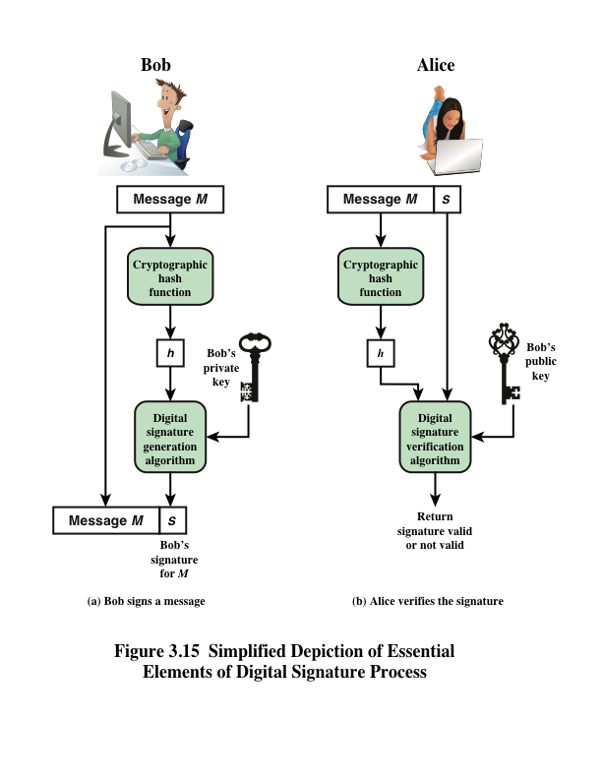
Notes:
Figure 3.15 is a generic model of the process of making and using digital signatures.
All of the digital signature schemes in FIPS 186-4 have this structure. Suppose that
Bob wants to send a message to Alice. Although it is not important that the message
be kept as a secret, he wants Alice to be certain that the message is indeed
from him. For this purpose, Bob uses a secure hash function, such as SHA-512, to
generate a hash value for the message. That hash value, together with Bob’s private
key, serve as input to a digital signature generation algorithm that produces a short
block that functions as a digital signature. Bob sends the message with the signature
attached. When Alice receives the message plus signature, she (1) calculates
a hash value for the message and (2) provides the hash value and Bob’s public key
as inputs to a digital signature verification algorithm. If the algorithm returns the
result that the signature is valid, Alice is assured that the message must have been
signed by Bob. No one else has Bob’s private key and therefore no one else could
have created a signature that could be verified for this message with Bob’s public
key. In addition, it is impossible to alter the message without access to Bob’s private
key, so the message is authenticated both in terms of source and in terms of
data integrity.
It is important to emphasize that the encryption process just described does
not provide confidentiality. That is, the message being sent is safe from alteration,
but not safe from eavesdropping. This is obvious in the case of a signature based
on a portion of the message, because the rest of the message is transmitted in
the clear. Even in the case of complete encryption, there is no protection of confidentiality
because any observer can decrypt the message by using the sender’s
public key.

Slide 42
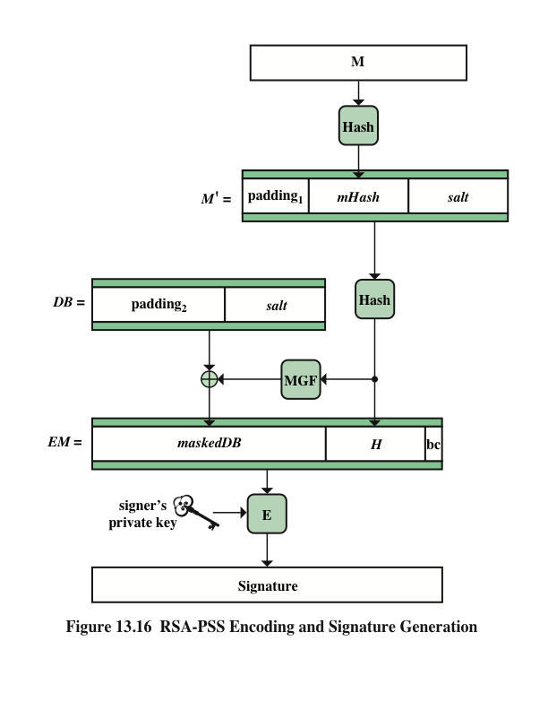
Notes:
The essence of the RSA digital signature algorithm is to encrypt the hash of the
message to be signed using RSA. However, as with the use of RSA for encryption of
keys or short messages, the RSA digital signature algorithm first modifies the hash
value to enhance security. There are several approaches to this, one of which is the
RSA Probabilistic Signature Scheme (RSA-PSS). RSA-PSS is the latest of the RSA
schemes and the one that RSA Laboratories recommends as the most secure of the
RSA digital signature schemes. We provide a brief overview here; for more detail
see [STAL16].
Figure 3.16 illustrates the RSS-PSS signature generation process.
The objective with this algorithm is to make it more difficult for an adversary
to find another message that maps to the same message digest as a given message or
to find two messages that map to the same message digest. Because the salt changes
with every use, signing the same message twice using the same private key will yield
two different signatures. This is an added measure of security.

Slide 43
Message authentication
Encryption protects against passive attack (eavesdropping)
A different requirement is to protect against active attack (falsification of data and transactions)
Protection against such attacks is known as message authentication
Message authentication is a procedure that allows communicating parties to verify that received messages are authentic
The two important aspects are to verify that the contents of the message have not been altered and that the source is authentic
Notes:
Encryption protects against passive attack (eavesdropping). A different requirement
is to protect against active attack (falsification of data and transactions).
Protection against such attacks is known as message authentication.
A message, file, document, or other collection of data is said to be authentic
when it is genuine and comes from its alleged source. Message authentication is a
procedure that allows communicating parties to verify that received messages are
authentic. The two important aspects are to verify that the contents of the message
have not been altered and that the source is authentic. We may also wish to
verify a message’s timeliness (it has not been artificially delayed and replayed) and
sequence relative to other messages flowing between two parties. All of these concerns
come under the category of data integrity as described in Chapter 1.

Slide 44
Message Authentication
Message authentication is concerned with:
– protecting the integrity of a message
– validating identity of originator
– non-repudiation of origin (dispute resolution)
The alternative functions used:
- message authentication code (MAC)
- hash function
- message encryption
- Digital Signature

Slide 45
Message Authentication Code (MAC)
Message Authentication Code (MAC) is a small block of data generated, appended and transmitted with the message
MAC is a function of the message, M as well as the common secret key, K_{AB} that is shared between two communicating parties, A and B.
– MAC_{M} = F(K_{AB},M)
MAC is a one way function
– From MAC, message M cannot be derived
The receiver performs same computation on message and checks it matches the received MAC
If a single bit of the message is changed the calculated MAC won’t match the transmitted MAC
A MAC is not a digital signature

Slide 46
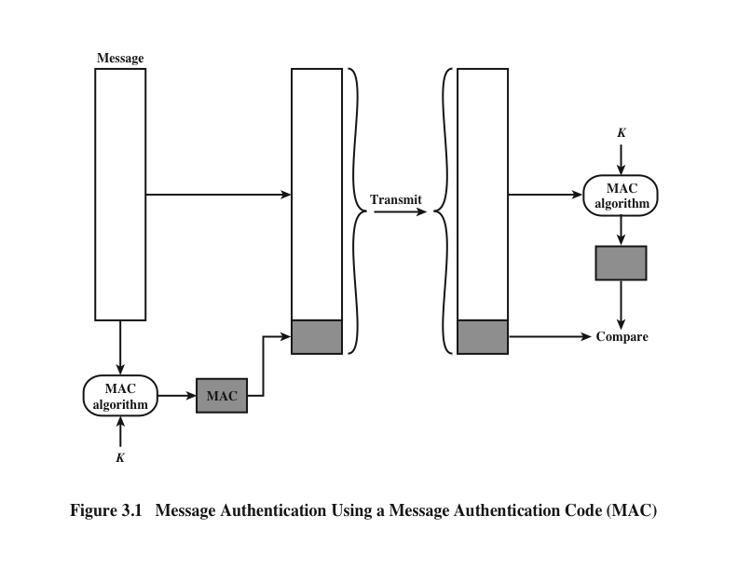
Notes:
One authentication technique involves the use
of a secret key to generate a small block of data, known as a message authentication
code (MAC) , that is appended to the message.
This technique assumes that
two communicating parties, say A and B, share a common secret key K_{AB}. When
A has a message to send to B, it calculates the message authentication code as a
function of the message and the key: MAC_{M} = F(K_{AB} , M ). The message plus code
are transmitted to the intended recipient. The recipient performs the same calculation
on the received message, using the same secret key, to generate a new message
authentication code. The received code is compared to the calculated code
(Figure 3.1).
If we assume that only the receiver and the sender know the identity
of the secret key, and if the received code matches the calculated code, then the following
statements apply:
1. The receiver is assured that the message has not been altered. If an attacker
alters the message but does not alter the code, then the receiver’s calculation
of the code will differ from the received code. Because the attacker is assumed
not to know the secret key, the attacker cannot alter the code to correspond to
the alterations in the message.
2. The receiver is assured that the message is from the alleged sender. Because
no one else knows the secret key, no one else could prepare a message with a
proper code.
3. If the message includes a sequence number (such as is used with HDLC and
TCP), then the receiver can be assured of the proper sequence, because an
attacker cannot successfully alter the sequence number.
A number of algorithms could be used to generate the code. The NIST specification,
FIPS PUB 113, recommends the use of DES. DES is used to generate an
encrypted version of the message, and the last number of bits of ciphertext are used
as the code. A 16- or 32-bit code is typical.
The process just described is similar to encryption. One difference is that the
authentication algorithm need not be reversible, as it must for decryption. Because
of the mathematical properties of the authentication function, it is less vulnerable to
being broken than encryption.

Slide 47
Hash Function Terminology
A hash function is a mathematical algorithm that maps data of any size to a bit string of a fixed size.
We can refer to the function input as message or simply as input. The fixed-size string function output is known as the hash or the message digest (MD). Hash functions used in cryptography have the following key properties:
It's easy and practical to compute the hash, but "difficult or impossible to re-generate the original input if only the hash value is known."
It's difficult to create an initial input that would match a specific desired output.
Thus, in contrast to encryption, hashing is a one-way mechanism. The data that is hashed cannot be practically "unhashed".

Slide 48
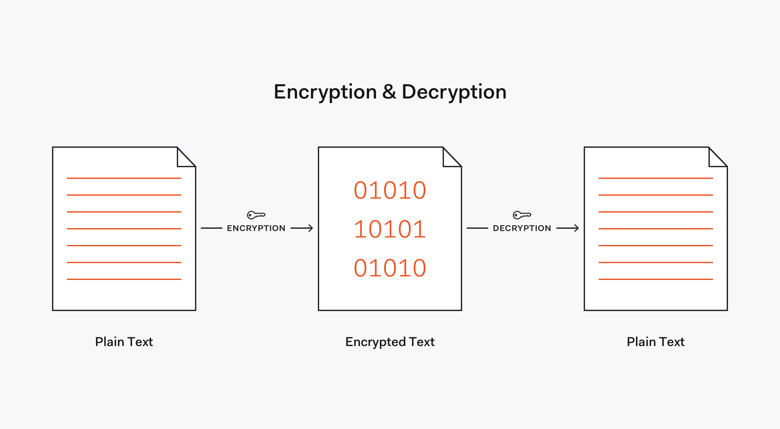
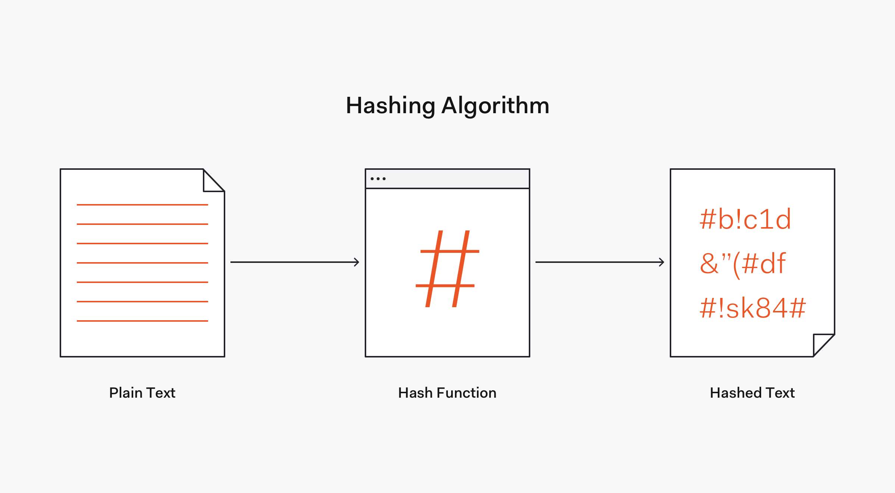

Slide 49
What is a hash function?
Hash algorithm
tx1tx2tx3
SHA-
256
tx1btx2tx3
a2fb19dfbf8f8473dafb8a439602bf2cbf4d87f68461bf02687d1e7a14ec528f
85f553fe554e5f3fef80f367adff04158c032e60c2d1f43f5ee47c462f1af4fe
https://www.xorbin.com/tools/sha256-hash-calculator

Slide 50
One-Way Hash Function
Like MAC, hash function is a one way function that accepts a message M and produces a fixed-size message digest H(M)
Unlike MAC, hash function takes only the message (not the key) as input to generate the message digest
Hash is used to detect changes to message
Can be used with both symmetric and asymmetric encryption
– used in various ways with message
– Most often to create a digital signature

Slide 51
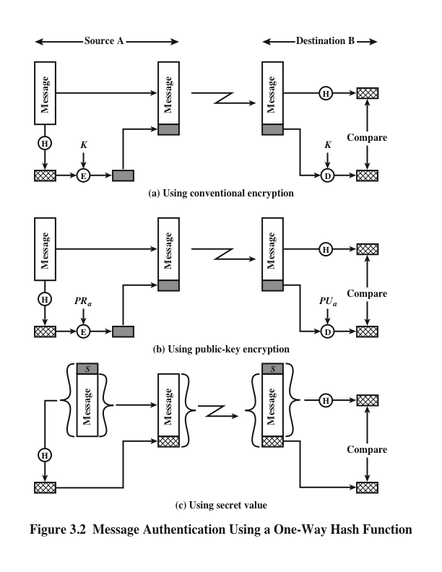
Notes:
Figure 3.2 illustrates three ways in which the message can be authenticated.
The message digest can be encrypted using conventional encryption (part a); if
it is assumed that only the sender and receiver share the encryption key, then
authenticity is assured. The message digest can be encrypted using public-key
encryption (part b); this is explained in Section 3.5. The public-key approach
has two advantages: (1) It provides a digital signature as well as message
authentication. (2) It does not require the distribution of keys to communicating
parties.
These two approaches also have an advantage over approaches that encrypt
the entire message in that less computation is required. Nevertheless, there has
been interest in developing a technique that avoids encryption altogether.
Figure 3.2c shows a technique that uses a hash function but no encryption for
message authentication. Because the secret value itself is
not sent, it is not possible for an attacker to modify an intercepted message. As long
as the secret value remains secret, it is also not possible for an attacker to generate
a false message.
A variation on the third technique, called HMAC, is the one adopted for
IP security (described in Chapter 9); it also has been specified for SNMPv3
(Chapter 13).

Slide 52
Hash Function
This techniques assume that A and B share a common secret value S_{AB}
A calculates hash function of secret value + Message, i.e., MD_{M}=H(S_{AB} || M)
M || MD_{M} is sent
B recalculates H(S_{AB} || M) and verify MD_{M}

Slide 53
Secure Hash Functions
Is important not only in message authentication but in digital signatures
Purpose is to produce a “fingerprint” of a file, message, or other block of data
To be useful for message authentication, a hash function H must have the following properties:
Notes:
The purpose of a hash function is to produce a “fingerprint” of a file, message, or
other block of data. To be useful for message authentication, a hash function H
must have the following properties:
1. H can be applied to a block of data of any size.
2. H produces a fixed-length output.
3. H(x ) is relatively easy to compute for any given x , making both hardware and
software implementations practical.
4. For any given code h , it is computationally infeasible to find x such that
H(x ) = h. A hash function with this property is referred to as one-way or
preimage resistant .
5. For any given block x, it is computationally infeasible to find y x with
H(y) = H(x). A hash function with this property is referred to as second preimage
resistant. This is sometimes referred to as weak collision resistant.
6. It is computationally infeasible to find any pair (x, y) such that H(x) = H(y).
A hash function with this property is referred to as collision resistant. This is
sometimes referred to as strong collision resistant.
A hash function that satisfies the first five properties in the preceding list is
referred to as a weak hash function. If the sixth property is also satisfied, then it is
referred to as a strong hash function. The sixth property, collision resistant, protects
against a sophisticated class of attack known as the birthday attack.

Slide 54
Requirement of Hash Function

Slide 55
Security of Hash Functions
There are two approaches to attacking a secure hash function:
Cryptanalysis
Involves exploiting logical weaknesses in the algorithm
Brute-force attack
The strength of a hash function against this attack depends solely on the length of the hash code produced by the algorithm
Notes:
As with symmetric encryption, there are two approaches to attacking a secure hash
function: cryptanalysis and brute-force attack. As with symmetric encryption algorithms,
cryptanalysis of a hash function involves exploiting logical weaknesses in the
algorithm.
The strength of a hash function against brute-force attacks depends solely on
the length of the hash code produced by the algorithm.
If collision resistance is required (and this is desirable for a general-purpose
secure hash code), then the value 2^{n/2} determines the strength of the hash code
against brute-force attacks. Van Oorschot and Wiener [VANO94] presented a
design for a $10 million collision search machine for MD5, which has a 128-bit
hash length, that could find a collision in 24 days. Thus, a 128-bit code may be
viewed as inadequate. The next step up, if a hash code is treated as a sequence
of 32 bits, is a 160-bit hash length. With a hash length of 160 bits, the same
search machine would require over four thousand years to find a collision. With
today’s technology, the time would be much shorter, so that 160 bits now
appears suspect.

Slide 56
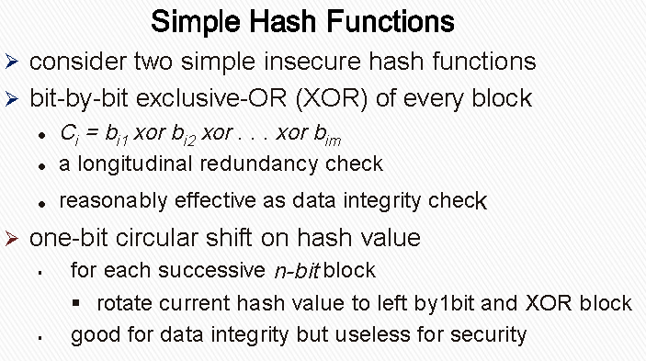
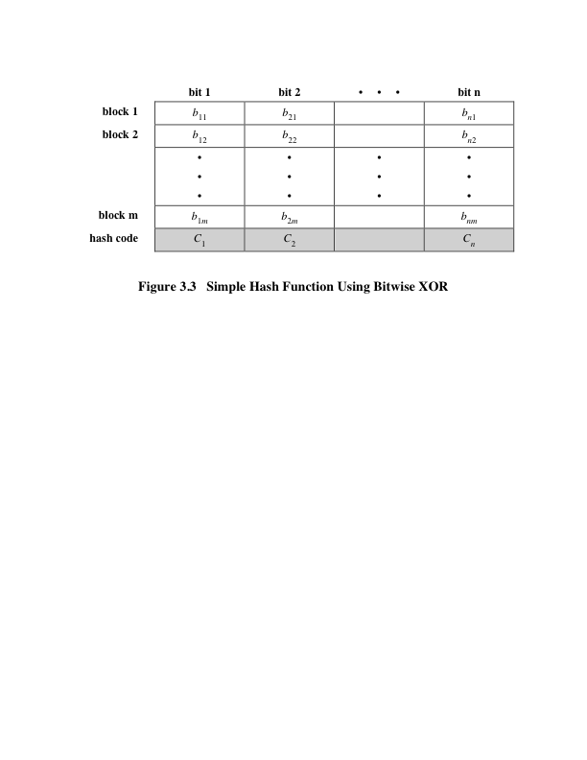
Notes:
All hash functions operate using the following general principles. The input (message,
file, etc.) is viewed as a sequence of n -bit blocks. The input is processed one
block at a time in an iterative fashion to produce an n -bit hash function.
One of the simplest hash functions is the bit-by-bit exclusive-OR (XOR) of
every block.
Figure 3.3 illustrates this operation; it produces a simple parity for each bit
position and is known as a longitudinal redundancy check.

Slide 57
Types of Hash Functions
MD2, MD4, MD5 - 128 bit message digest
– developed by Ronald Rivest
– There are many successful attacks to MD2, MD4, MD5
SHA, SHA-1 -160 bit message digest
– On February 23, 2017 CWI Amsterdam and Google announced they had performed a collision attack against SHA-1, publishing two dissimilar PDF files which produce the same SHA-1 hash [1]
SHA-256 - 256 bit message digest
SHA-384 - 384 bit message digest
SHA-512 - 512 bit message digest
SHA (Secure Hash Algorithm) – 256, 384, 512-bit have been proposed to use with AES-128, 192 and 512 bit encryption by the National Institute of Standards & Technology, USA
[1] https://security.googleblog.com/2017/02/announcing-first-sha1-collision.html

Slide 58
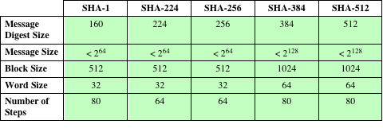
Table 3.1 Comparison of SHA Parameters
Note: All sizes are measured in bits.
Notes:
In 2002, NIST produced a revised
version of the standard, FIPS 180-2, that defined three new versions of SHA with
hash value lengths of 256, 384, and 512 bits known as SHA-256, SHA-384, and
SHA-512, respectively. Collectively, these hash algorithms are known as SHA-2 .
These new versions have the same underlying structure and use the same types of
modular arithmetic and logical binary operations as SHA-1. A revised document
was issued as FIP PUB 180-3 in 2008, which added a 224-bit version (Table 3.1).
SHA-1 and SHA-2 are also specified in RFC 6234, which essentially duplicates the
material in FIPS 180-3 but adds a C code implementation.

Slide 59
SHA-512
Step 1: Append padding bits
Step 2: Append length
Step 3: Initialize hash buffer
Step 4: Process the message in 1024-bit (128-word) blocks, which forms the heart of the algorithm
Step 5: Output the final state value as the resulting hash

Slide 60
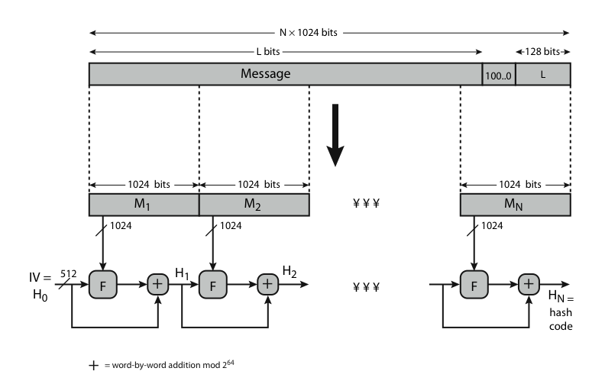
SHA-512 Overview

Slide 61
SHA-512 Compression Function
heart of the algorithm
processing message in 1024-bit blocks
consists of 80 rounds
updating a 512-bit buffer
using a 64-bit value Wt derived from the current message block
and a round constant based on cube root of first 80 prime numbers
Notes:
The SHA-512 Compression Function is the heart of the algorithm. In this Step 4, it processes the message in 1024-bit (128-word) blocks, using a module that consists of 80 rounds, labeled F in Stallings Figure 12, as shown in Figure 12.2. Each round takes as input the 512-bit buffer value, and updates the contents of the buffer. Each round t makes use of a 64-bit value Wt derived using a message schedule from the current 1024-bit block being processed. Each round also makes use of an additive constant Kt, based on the fractional parts of the cube roots of the first eighty prime numbers. The output of the eightieth round is added to the input to the first round to produce the final hash value for this message block, which forms the input to the next iteration of this compression function, as shown on the previous slide.

Slide 62
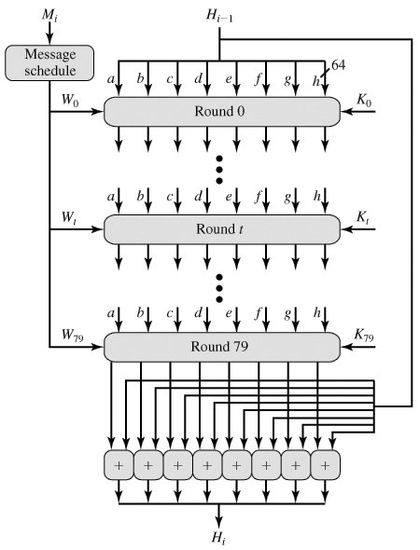

Slide 63
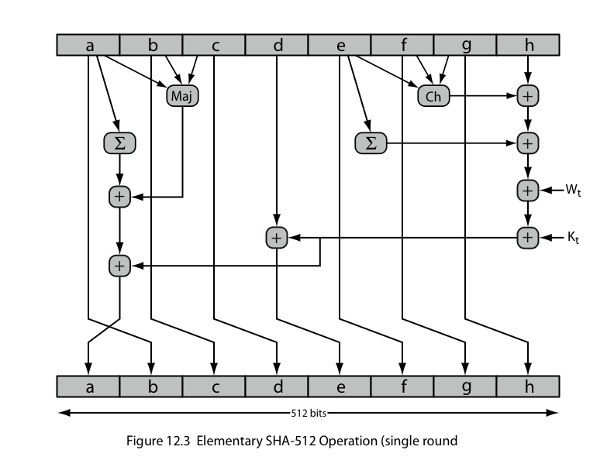
SHA-512 Round Function
Notes:
The structure of each of the 80 rounds is shown in Stallings Figure 12.3. Each 64-bit word shuffled along one place, and in some cases manipulated using a series of simple logical functions (ANDs, NOTs, ORs, XORs, ROTates), in order to provide the avalanche & completeness properties of the hash function. The elements are:
Ch(e,f,g) = (e AND f) XOR (NOT e AND g)
Maj(a,b,c) = (a AND b) XOR (a AND c) XOR (b AND c)
∑(a) = ROTR(a,28) XOR ROTR(a,34) XOR ROTR(a,39)
∑(e) = ROTR(e,14) XOR ROTR(e,18) XOR ROTR(e,41)
+ = addition modulo 2^64
Kt = a 64-bit additive constant
Wt = a 64-bit word derived from the current 512-bit input block.

Slide 64
Function Elements
Ch(e,f,g) = (e AND f) XOR (NOT e AND g)
Maj(a,b,c) = (a AND b) XOR (a AND c) XOR (b AND c)
∑(a) = ROTR(a,28) XOR ROTR(a,34) XOR ROTR(a,39)
∑(e) = ROTR(e,14) XOR ROTR(e,18) XOR ROTR(e,41)
+ = addition modulo 2^64
Kt = a 64-bit additive constant
Wt = a 64-bit word derived from the current 512-bit input block.

Slide 65
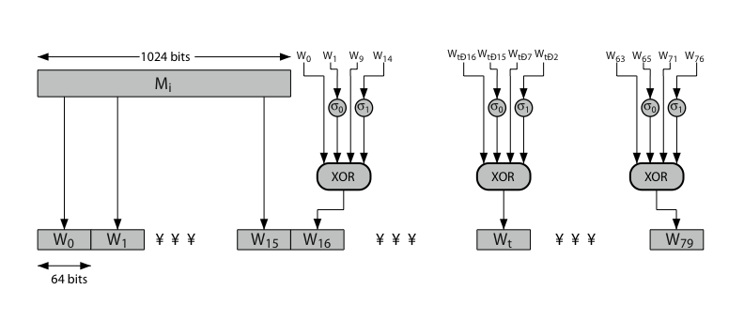
SHA-512 Round Function
Notes:
Stallings Figure 12.4 details how the 64-bit word values Wt are derived from the 1024-bit message. The first 16 values of Wt are taken directly from the 16 words of the current block. The remaining values are defined as a function of the earlier values using ROTates, SHIFTs and XORs as shown. The function elements are:
∂0(x) = ROTR(x,1) XOR ROTR(x,8) XOR SHR(x,7)
∂1(x) = ROTR(x,19) XOR ROTR(x,61) XOR SHR(x,6).

Slide 66
Sha-3
Basic requirements that must be satisfied by any candidate for SHA-3
1. It must be possible to replace SHA-2 with SHA-3 in any application by a simple drop-in substitution. Therefore, SHA-3 must support hash value lengths of 224, 256, 384, and 512 bits.
2. SHA-3 must preserve the online nature of SHA-2. That is, the algorithm must process comparatively small blocks (512 or 1024 bits) at a time instead of requiring that the entire message be buffered in memory before processing it.
Notes:
SHA-2, particularly the 512-bit version, would appear to provide unassailable security.
However, SHA-2 shares the same structure and mathematical operations
as its predecessors, and this is a cause for concern. Because it would take years to find a
suitable replacement for SHA-2, should it become vulnerable, NIST announced in
2007 a competition to produce the next-generation NIST hash function, which is to
be called SHA-3. Following are the basic requirements that must be satisfied by any
candidate for SHA-3:
1. It must be possible to replace SHA-2 with SHA-3 in any application by a simple
drop-in substitution. Therefore, SHA-3 must support hash value lengths of
224, 256, 384, and 512 bits.
2. SHA-3 must preserve the online nature of SHA-2. That is, the algorithm must
process comparatively small blocks (512 or 1024 bits) at a time instead of
requiring that the entire message be buffered in memory before processing it.
In 2012, NIST selected a winning submission and formally published SHA-3.
A detailed presentation of SHA-3 is provided in Chapter 15.

Slide 67
HMAC
There has been an increased interest in developing a MAC derived from a cryptographic hash code, such as SHA-1
Cryptographic hash functions generally execute faster in software than conventional encryption algorithms such as DES
Library code for cryptographic hash functions is widely available
A hash function such as SHA-1 was not designed for use as a MAC and cannot be used directly for that purpose because it does not rely on a secret key
There have been a number of proposals for the incorporation of a secret key into an existing hash algorithm
The approach that has received the most support is HMAC
HMAC
Has been issued as RFC 2104
Has been chosen as the mandatory-to-implement MAC for IP Security
Is used in other Internet protocols, such as Transport Layer Security (TLS) and Secure Electronic Transaction (SET)
Notes:
In recent years, there has been increased interest in developing a MAC derived
from a cryptographic hash code, such as SHA-1. The motivations for this interest
are as follows:
• Cryptographic hash functions generally execute faster in software than conventional
encryption algorithms such as DES.
• Library code for cryptographic hash functions is widely available.
A hash function such as SHA-1 was not designed for use as a MAC and cannot
be used directly for that purpose because it does not rely on a secret key. There have
been a number of proposals for the incorporation of a secret key into an existing hash
algorithm. The approach that has received the most support is HMAC [BELL96a,
BELL96b]. HMAC has been issued as RFC 2104, has been chosen as the mandatory-to-
implement MAC for IP Security, and is used in other Internet protocols, such as
Transport Layer Security (TLS) and Secure Electronic Transaction (SET).

Slide 68
HMAC Design Objectives
To use, without modifications, available hash functions --- in particular, hash functions that perform well in software, and for which code is freely and widely available
To allow for easy replaceability of the embedded hash function in case faster or more secure hash functions are found or required
To preserve the original performance of the hash function without incurring a significant degradation
To use and handle keys in a simple way
To have a well understood cryptographic analysis of the strength of the authentication mechanism based on reasonable assumptions on the embedded hash function
Notes:
RFC 2104 lists the following design objectives for
HMAC.
• To use, without modifications, available hash functions. In particular, hash
functions that perform well in software, and for which code is freely and
widely available
• To allow for easy replaceability of the embedded hash function in case faster
or more secure hash functions are found or required
• To preserve the original performance of the hash function without incurring a
significant degradation
• To use and handle keys in a simple way
• To have a well-understood cryptographic analysis of the strength of the
authentication mechanism based on reasonable assumptions on the embedded
hash function
The first two objectives are important to the acceptability of HMAC. HMAC
treats the hash function as a “black box.” This has two benefits. First, an existing
implementation of a hash function can be used as a module in implementing
HMAC. In this way, the bulk of the HMAC code is prepackaged and ready to use
without modification. Second, if it is ever desired to replace a given hash function
in an HMAC implementation, all that is required is to remove the existing hash
function module and drop in the new module. This could be done if a faster hash
function were desired. More important, if the security of the embedded hash function
were compromised, the security of HMAC could be retained simply by replacing
the embedded hash function with a more secure one
.
The last design objective in the preceding list is, in fact, the main advantage
of HMAC over other proposed hash-based schemes. HMAC can be proven secure
provided that the embedded hash function has some reasonable cryptographic
strengths. We return to this point later in this section, but first we examine the structure
of HMAC.

Slide 69
HMAC OPERATION
specified as Internet standard RFC2104
uses hash function on the message:
HMAC_{K} = Hash[(K⁺ XOR opad) ||
Hash[(K⁺ XOR ipad)||M)]]
where K⁺ is the key padded out to size
and opad, ipad are specified padding constants
overhead is just 3 more hash calculations than the message needs alone
any hash function can be used
eg. MD5, SHA-1, RIPEMD-160, Whirlpool
Notes:
The idea of a keyed hash evolved into HMAC, designed to overcome some problems with the original proposals. It involves hashing padded versions of the key concatenated with the message, and then with another outer hash of the result prepended by another padded variant of the key. The hash function need only be used on 3 more blocks than when hashing just the original message (for the two keys + inner hash). HMAC can use any desired hash function, and has been shown to have the same security as the underlying hash function. Can choose the hash function to use based on speed/security concerns.

Slide 70
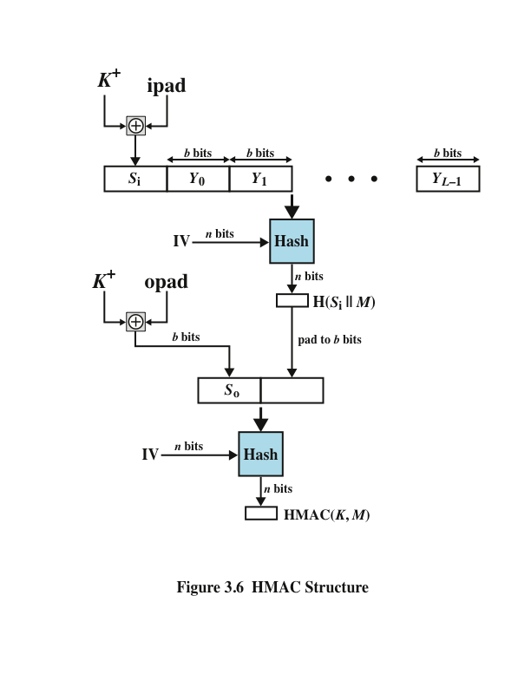
Notes:
Figure 3.6 illustrates the overall operation of HMAC.

Slide 71
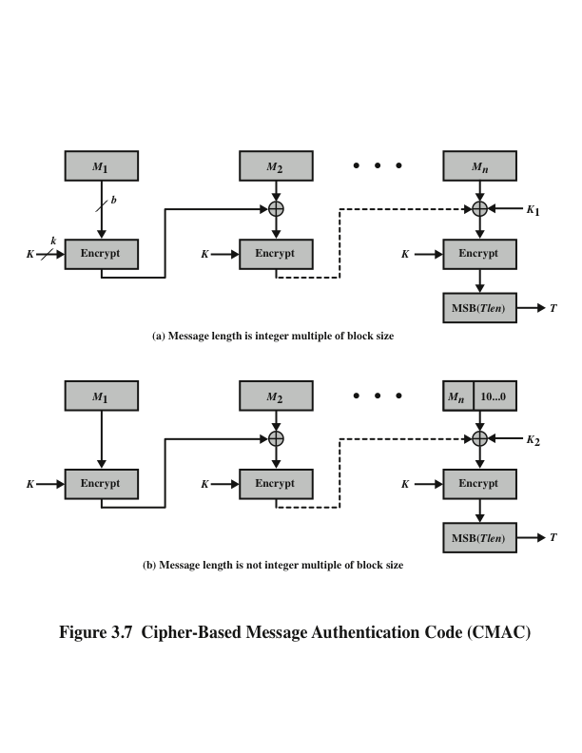
Notes:
The Cipher-based
Message Authentication Code mode of operation is for use with AES and triple
DES. It is specified in NIST Special Publication 800-38B.

Slide 72
Counter with Cipher Block Chaining-Message Authentication Code (CCM)
Key algorithmic ingredients
AES encryption algorithm
CTR mode of operation
CMAC authentication algorithm
NIST standard SP 800-38C
Referred to as an authenticated encryption mode
“Authenticated encryption” is a term used to describe encryption systems that simultaneously protect confidentiality and authenticity of communications
A single key is used for both encryption and MAC algorithms
Notes:
The Counter with Cipher Block Chaining-Message Authentication Code (CCM)
mode of operation, defined in NIST SP 800-38C, is referred to as an authenticated
encryption mode. “Authenticated encryption” is a term used to describe encryption
systems that simultaneously protect confidentiality and authenticity (integrity) of
communications. Many applications and protocols require both forms of security,
but until recently the two services have been designed separately.
The key algorithmic ingredients of CCM are the AES encryption algorithm
(Section 2.2), the CTR mode of operation (Section 2.5), and the CMAC authentication
algorithm. A single key K is used for both encryption and MAC algorithms.

Slide 73
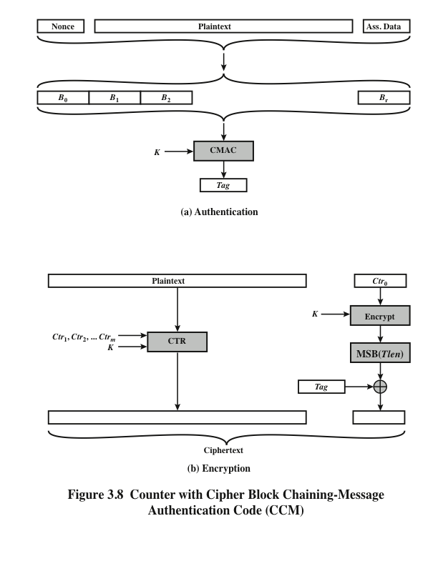
Notes:
Figure 3.8 illustrates the operation of CCM. For authentication, the input
includes the nonce, the associated data, and the plaintext. This input is formatted as
a sequence of blocks B₀ through B_{r} . The first block contains the nonce plus some
formatting bits that indicate the lengths of the N , A , and P elements. This is followed
by zero or more blocks that contain A , followed by zero of more blocks that
contain P. The resulting sequence of blocks serves as input to the CMAC algorithm,
which produces a MAC value with length Tlen , which is less than or equal to the
block length (Figure 3.8a).
For encryption, a sequence of counters is generated that must be independent
of the nonce. The authentication tag is encrypted in CTR mode using the single
counter Ctr₀ . The Tlen most significant bits of the output are XORed with the tag
to produce an encrypted tag. The remaining counters are used for the CTR mode
encryption of the plaintext (Figure 2.11). The encrypted plaintext is concatenated
with the encrypted tag to form the ciphertext output (Figure 3.8b).

Slide 74
HMAC Security
Proved security of HMAC relates to that of the underlying hash algorithm
Attacking HMAC requires either:
– brute force attack on key used
– birthday attack (but since keyed would need to observe a very large number of messages)
choose hash function used based on speed verses security constraints

Slide 75
Further Reading
Chapter 3 of the textbook: Network Security Essentials-Application & Standards” by William Stallings 6th Edition, PrenticeHall, 2017

